Slide 1
Final Project- Applied Data Science Capstone
Author: Chen Ts-Pei
Date: 2020/12/17

Slide 2
Outline
Introduction:
Outdoor sport trend in Taipei
Business Opportunity
Data Source
Target at the main 8 river parks
Explore venues nearby 8 parks
Methodology
Categories, Locations, Distance
Data-preprocess
Data Analysis
K-means Algorithm
Result
Reference

Slide 3
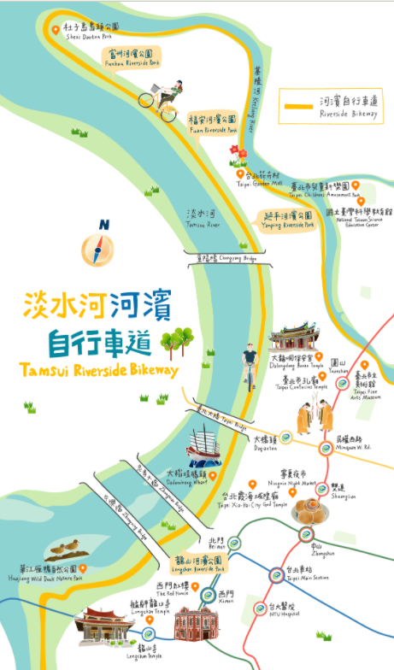
Introduction: Outdoor sport trend in Taipei
Taipei is one of the most populous city in Taiwan. People live or work in this busy city might find a silent place to enjoy their silent time. Therefore, outdoor events such as hiking or biking in the suburb of Taipei became trendy in recent years.
When it comes to biking in Taipei, almost every one would think of the bike trail along Tamshui River(淡水河), which is the biggest river goes across Taipei. In order to boost this casual event and attract more visitors, the government built more river parks for bikers resting and entertainment. Also, The government are promoting tourisms nearby the bike trail such as historical sites, art museum, night markets, etc. to demonstrate the energy of this gorgeous city.

Slide 4
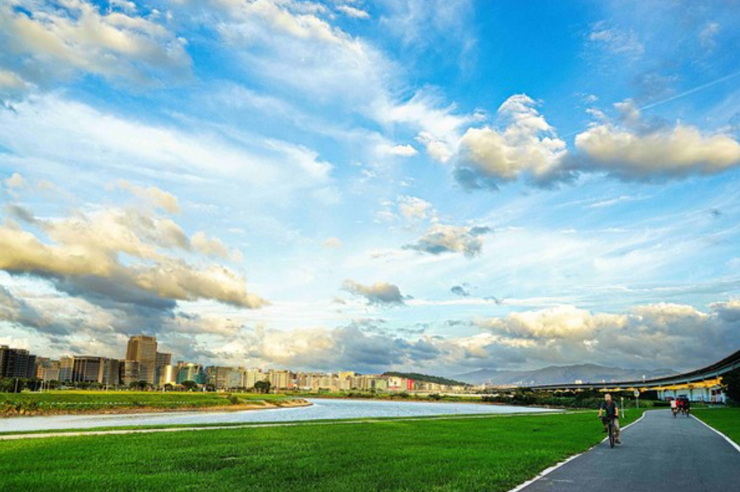
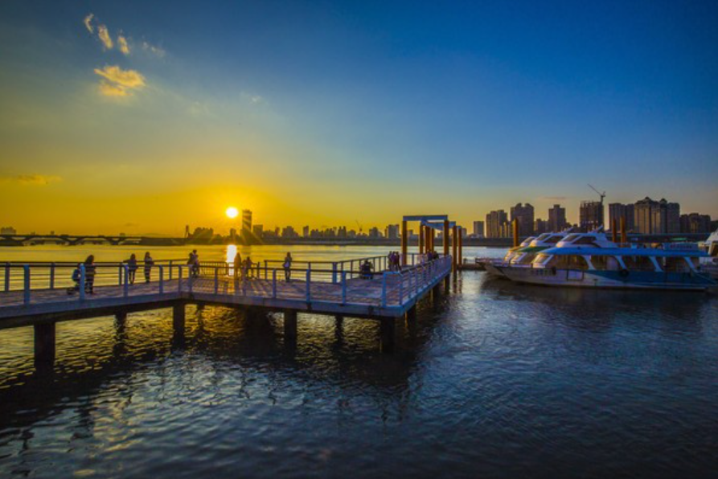
Introduction: Business Opportunity
The promotion of this event also encourages more people exploring trending venues nearby the bike trails, which leads to a rising number of businessmen to setup stores here.
Now, we might have the following problems:
Which location do the businessmen decide to setup their stores?
Which type of the venue is the most common in these neighborhood?
Would the venue be popular if it is near the river park?

Slide 5
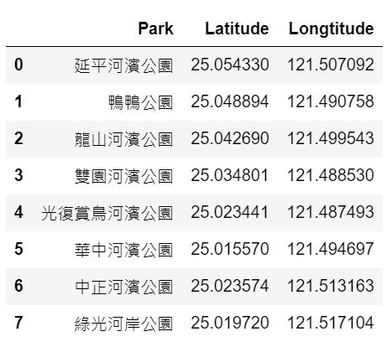
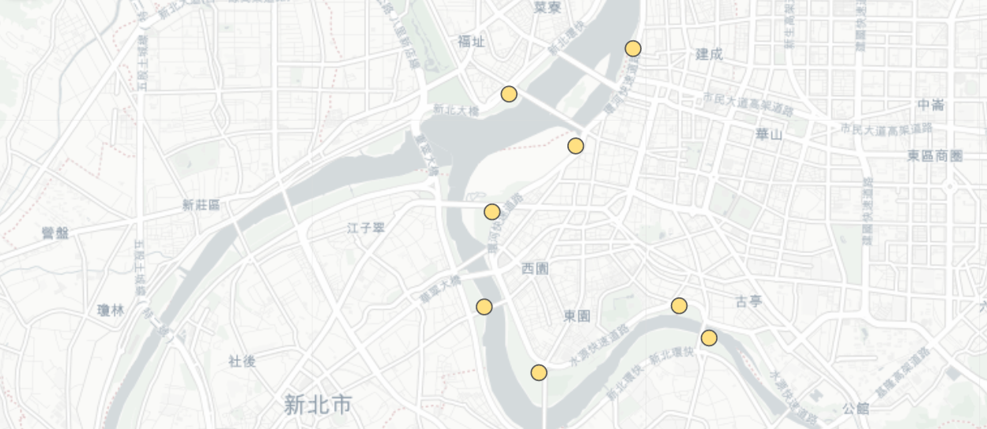
Data Source: Target at the main 8 river parks
Refer to the information offered by the government of Taipei, we select the 8 river parks located along Tamshui River, which are:
DataFrame made by pandas
Map made by folium

Slide 6
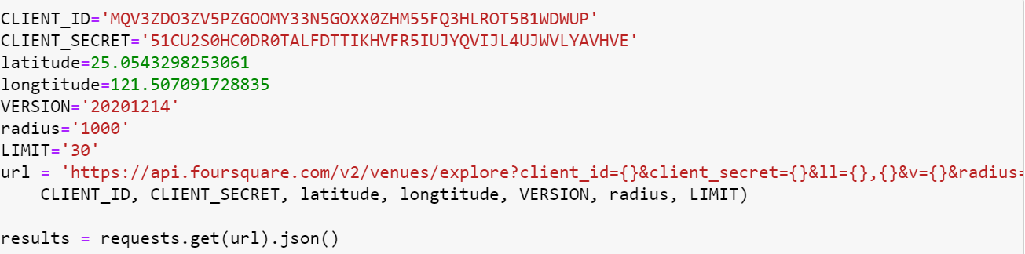
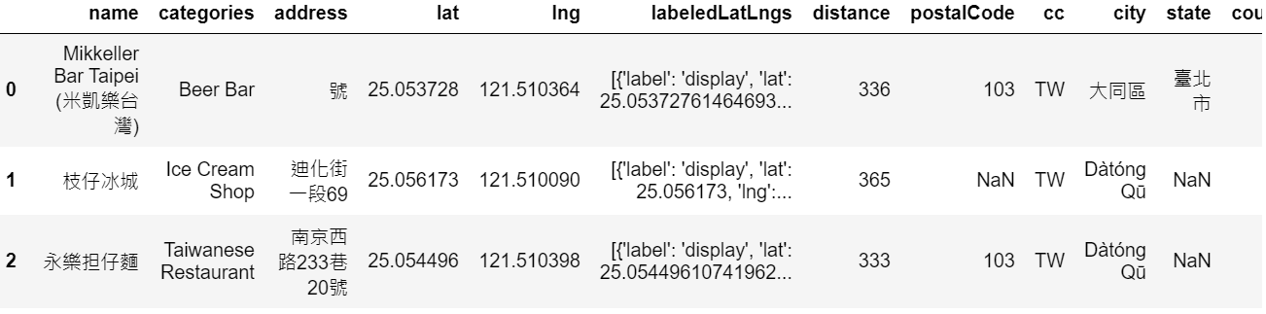
Data Source: Explore venues nearby 8 parks
Use the Foursquare API to learn the information of venues nearby the 8 river parks. And flatten the json file into the dataframe.

Slide 7
Methodology: Categories, Locations, Distance
As mentioned above, we are curios about these fundamental questions, and we’ll use three index to analyze these questions:
Which location do the businessmen decide to setup their stores?
The latitude and longitude of these venues
Which type of the venue is the most common in these neighborhood?
The category of these venues
Would the venue be popular if it is near the river park?
The distance between those river parks and venues

Slide 8
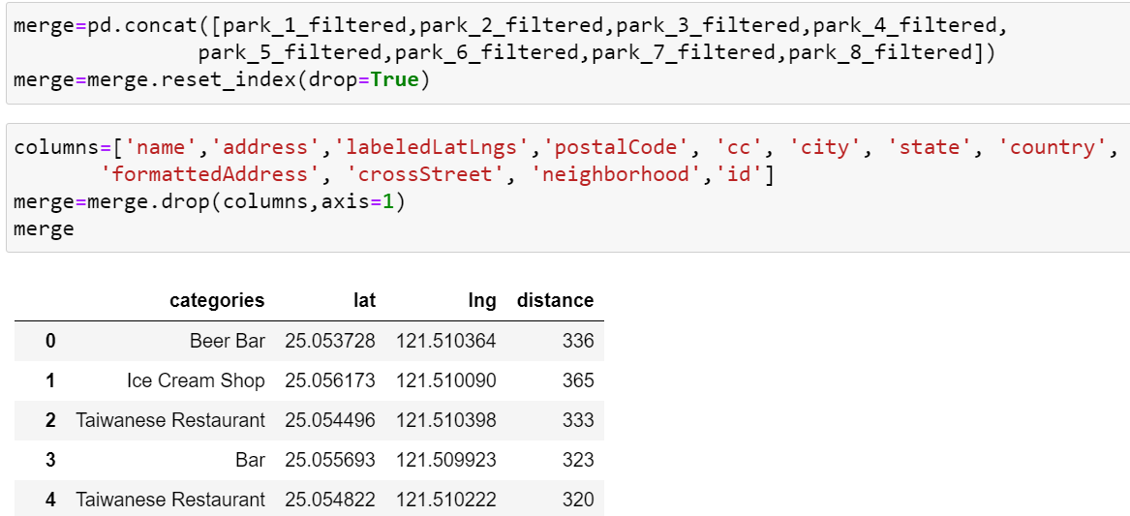
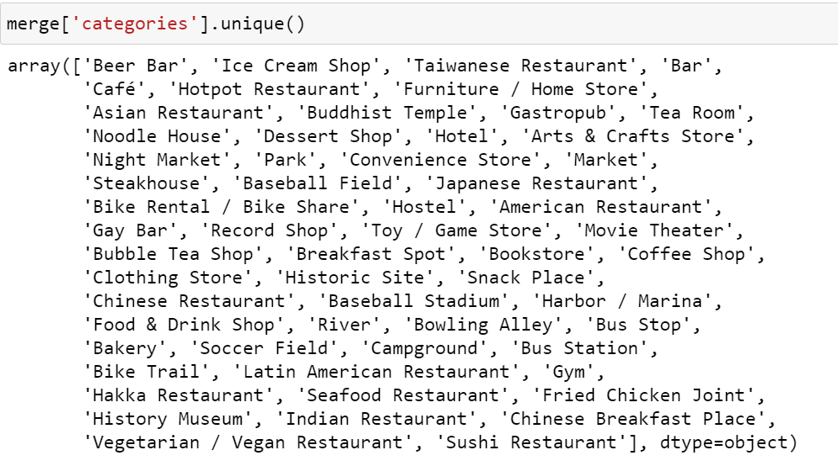
Methodology: Data-preprocess
After merging and cleaning the data, we found that there were 61 categories among 161 venues, so we need to process the data in detailed.

Slide 9
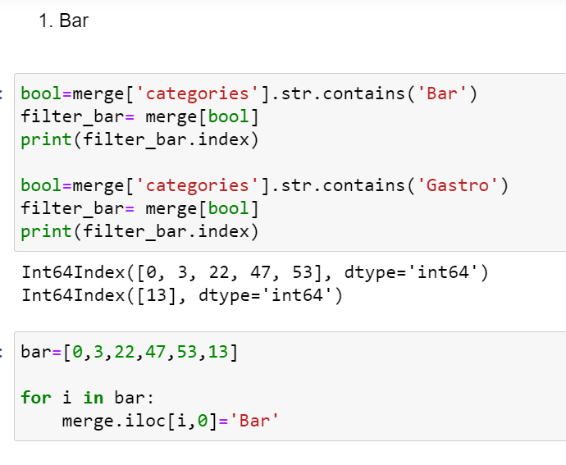
Methodology: Data-preprocess
Re-group the categories into 20 main categories:
Bar
Local Restaurants
Japanese Foods
Asian Restaurants
Natural Scenery
Drinking Shops
Café
Desserts
American Restaurants
Local food stands
Breakfast
Souvenir and Gift shops
Grocery
Historical spot and museum
Accomodation
Sport Place
Bus Stop
Entertainment
Markets
Park

Slide 10
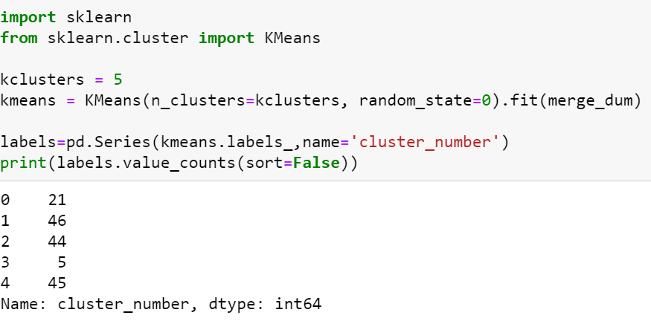
Data Analysis: K-means clustering
We utilize the sklearn package to conduct the k-means clustering

Slide 11
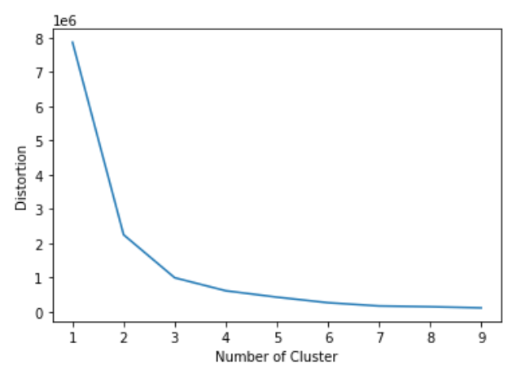
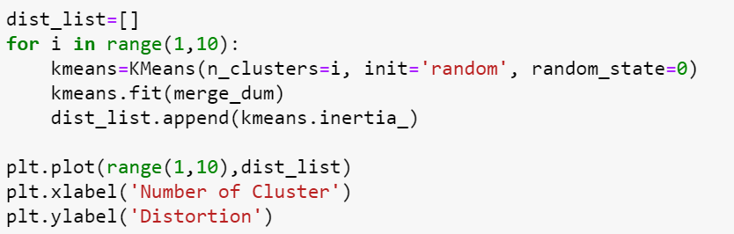
Data Analysis: K-means clustering
Then use the elbow method to select a proper k:
K=3 or 4

Slide 12
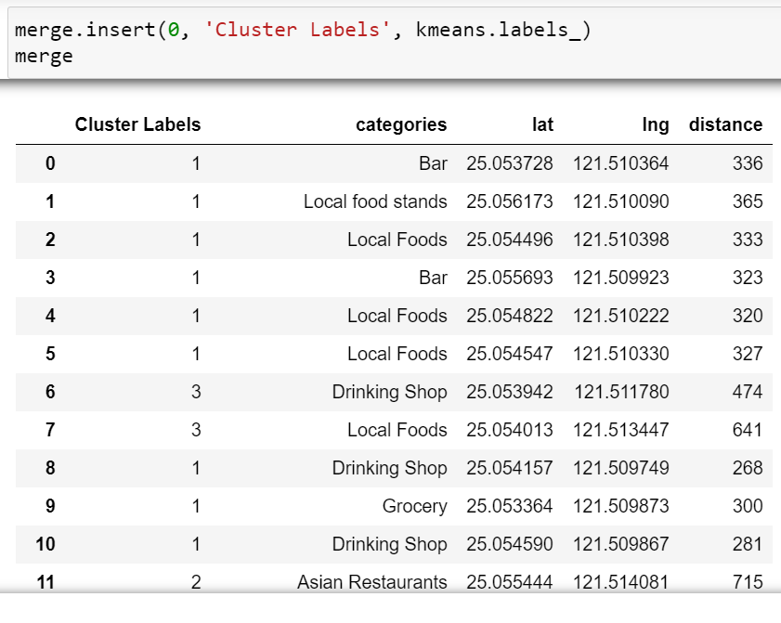
Result: Four clusters along the river side

Slide 13
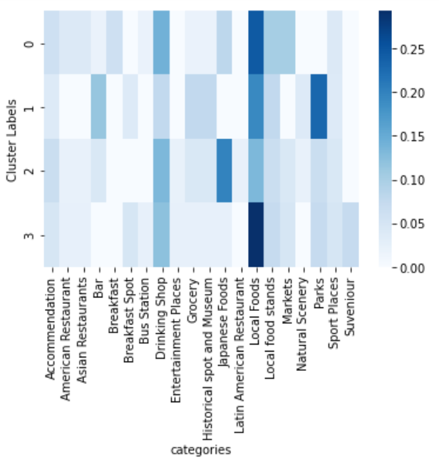
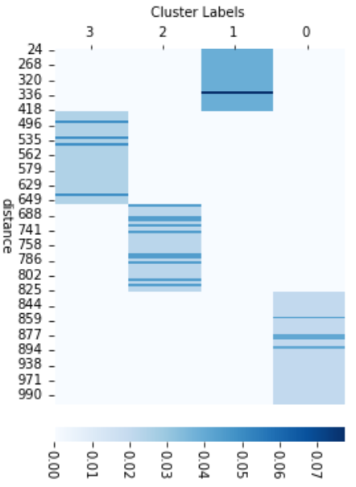
Result: Visualized Heatmap
Heatmap is an useful tool to learn the correlation between the index. From the left-side heat map, we can understand that there is no specific relationship between the distance and the clusters. On the other hand, there could be some correlation between categories of venues and clusters.

Slide 14
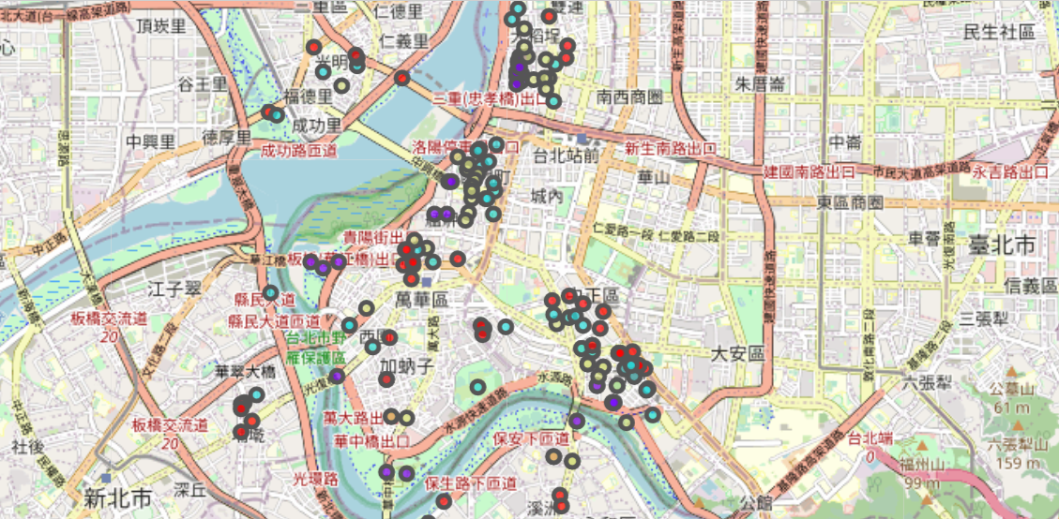
Result: Visualized Map
In the end, from this map we can learn the location of these venues and the clusters.

Slide 15
Reference
https://www.travel.taipei/zh-tw/must-visit/riverside-bikeway

